Slide 1
Introduction to Business Economics and Financial Analysis
Dr. T. Roja Rani
PhD, MBA, M.A.

Slide 2
Introduction
What is Economics:
The study of how limited resources is used to satisfy unlimited human wants.

Slide 3
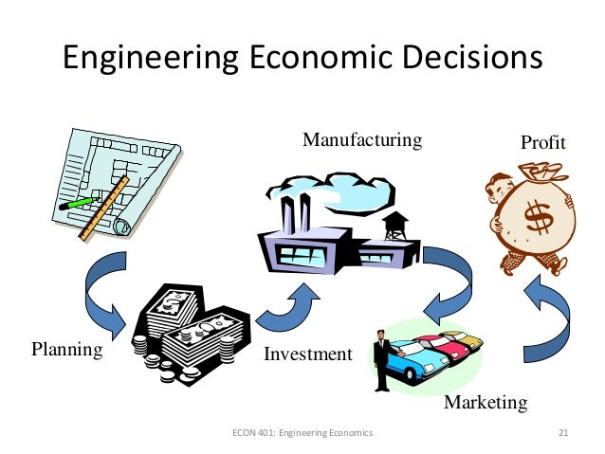

Slide 4
Applications in Managerial Economics:
Demand Decisions
Input-Output Decisions
Price-Output Decisions
Profit related Decisions
Investment Decisions
Economic Forecasting and Forward Planning

Slide 5
Role of Business Economist
In India, a Business Economist is expected to perform the following functions:
Macro forecasting for demand and supply
Production Planning
Economic feasibility of new production lines or new projects

Slide 6
Assistance in preparation of overall development plans.
Risk Analysis
Production Analysis
Capital Budgeting
Decision-making process.

Slide 7
THANK YOU

